Slide 1


Denis Remo
March 17th 2024

Slide 2

Outline
Executive Summary
Introduction
Methodology
Results
Conclusion
Appendix

Slide 3
Executive Summary
The analysis commenced with Exploratory Data Analysis (EDA) to gain insights into the dataset's structure, features, and distributions, focusing on predicting the success of the first stage landing of Falcon 9 rockets. Subsequently, data preprocessing steps were executed to standardize features and partition the dataset into training and testing subsets.
Four classification algorithms were assessed: Logistic Regression, Support Vector Machine (SVM), Decision Tree, and K Nearest Neighbors (KNN). Each model underwent hyperparameter tuning via GridSearchCV with cross-validation.
Results revealed that both Logistic Regression and SVM achieved comparable test accuracies of approximately 83.3%. The Decision Tree model showcased superior performance with a training accuracy of 88.9%, although the test accuracy for Decision Tree was not provided. Notably, KNN results were not included, potentially due to an oversight or omission.
Considering the performance metrics, the Decision Tree model emerged as the preferred choice for predicting Falcon 9 first stage landings due to its higher training accuracy. However, it is imperative to validate its performance on the test set to ensure its generalization ability.

Slide 4
Introduction
A new rocket company, Space Y, would like to compete with SpaceX
Space Y was founded by billionaire industrialist Allon Musk.
The main purpose of this project is to determine the price of each launch by gathering information about Space X and creating dashboards
It could determine if SpaceX will reuse the first stage.
Instead of using rocket science to determine if the first stage will land successfully, a machine learning model could be trained and use public information to predict if SpaceX will reuse the first stage.

Slide 5

Section 1

Slide 6
Methodology
Executive Summary
Data collection methodology:
Perform data wrangling
Perform exploratory data analysis (EDA) using visualization and SQL
Perform interactive visual analytics using Folium and Plotly Dash
Predictive analysis using classification models

Slide 7
Data Collection
The datasets used in this analysis were collected through a multi-step process that involved several techniques, including API requests, data wrangling, and filtering. Here's an expanded explanation of each step:
API Requests: The initial step likely involved gathering data from various sources using API (Application Programming Interface) requests. APIs provide a structured and programmatic way to access data from online sources. For example, data about launch sites, their coordinates, and launch outcomes may have been obtained from sources such as SpaceX's API or other space agencies' APIs.
Data Wrangling: After obtaining the raw data through API requests, the next step was likely data wrangling. Data wrangling involves cleaning, transforming, and restructuring the raw data into a format suitable for analysis. This process may include tasks such as handling missing values, removing duplicates, converting data types, and reshaping the data into a more structured form.
Filtering: Once the data was cleaned and structured, it was filtered to extract relevant information for the analysis. This likely involved selecting specific columns or variables of interest, such as launch site names, coordinates, launch outcomes (success or failure), and any other relevant attributes.
Augmentation: In some cases, additional data may have been augmented or added to the original dataset to enhance its analytical capabilities. For example, latitude and longitude coordinates may have been added to each launch site to enable geographic visualization and analysis.
Integration: If data was collected from multiple sources, integration may have been necessary to combine datasets into a single cohesive dataset for analysis. This ensures that all relevant information is available in one place for analysis and interpretation.
Overall, the process of collecting and preparing the datasets involved a combination of techniques aimed at ensuring data quality, relevance, and suitability for the subsequent analysis tasks. This systematic approach lays the foundation for meaningful insights and conclusions to be drawn from the data.

Slide 8
Data Collection – SpaceX API
Start
Initialize API URL
Initialization:
Begin by initializing the URL for the SpaceX API endpoint.
GET Request:
Make a GET request to the SpaceX API to retrieve data.
Response Handling:
Check if the response is successful.
If successful, decode the JSON content.
If not successful, handle errors appropriately.
Data Processing:
Convert the JSON response to a Pandas DataFrame.
Filter the data as necessary (e.g., removing irrelevant columns or rows).
Additional Processing:
Perform additional processing or analysis on the data, such as converting data types or calculating derived metrics.
Export to CSV:
Export the processed data to a CSV file for further analysis or sharing.
By following this process and using the provided flowchart, data can be collected efficiently and effectively from the SpaceX API for further analysis or integration into other applications.
https://github.com/DenisSRemo/Coursera/tree/main/Applied%20Data%20Science%20Capstone
Successful Response?
Make GET Request
No
Yes
Handle Error
Decode JSON
Filter Data
Convert to DataFrame
No
Export to CSV
Yes
Process Data

Slide 9
Data Collection - Scraping
Initialization:
Begin by identifying the target website and initializing the URL.
HTTP Request:
Make an HTTP request to the target website to retrieve the HTML content.
Response Handling:
Check if the response is successful.
If successful, parse the HTML content.
If not successful, handle errors appropriately.
HTML Parsing:
Use a parsing library (e.g., BeautifulSoup) to extract relevant data from the HTML content.
Identify the structure of the HTML elements containing the desired data.
Data Extraction:
Extract specific data elements from the parsed HTML based on their tags, attributes, or position within the document.
Clean and preprocess the extracted data as necessary (e.g., removing unnecessary characters or formatting).
Data Storage:
Store the extracted data in a suitable data structure (e.g., list, dictionary, Pandas DataFrame).
Export to CSV or Database:
Export the extracted data to a CSV file or database for further analysis or integration into other applications.
By following this process and using the provided flowchart, web scraping can be performed effectively to extract data from websites for various purposes, such as data analysis, research, or building datasets.
https://github.com/DenisSRemo/Coursera/tree/main/Applied%20Data%20Science%20Capstone
Start
Navigate to Website
Receive Response
Send HTTP Request
Not Successful
Successful
End/Retry
Parse HTML
Data Processing
Extract Data
Store Data
End

Slide 10
Data Wrangling
Start
HTTP Request
To process the data and perform data wrangling, the following steps were undertaken:
HTTP Request: An HTTP GET request was made to the Wikipedia page containing the Falcon 9 launch records.
HTML Parsing: The HTML content of the response was parsed using BeautifulSoup to extract meaningful information.
Identifying Target Table: The target table containing the Falcon 9 launch records was identified by inspecting the HTML structure of the page.
Extracting Column Names: The column names were extracted from the table header to understand the structure of the data.
Parsing Table Data: The data from the table cells were parsed using specific functions designed to extract relevant information such as date and time, booster version, landing status, etc.
Cleaning and Transformation: The extracted data were cleaned and transformed as necessary, including handling special characters, converting data types, and filtering irrelevant information.
Conversion to DataFrame: Finally, the processed data were converted into a Pandas DataFrame for further analysis and visualization.
This data wrangling process involved systematically extracting, cleaning, and structuring the raw HTML data into a format suitable for analysis and interpretation.
https://github.com/DenisSRemo/Coursera/tree/main/Applied%20Data%20Science%20Capstone
Identify Target Table
HTTP Parsing
Extract Column Names
Parse Table Data
Conversion to DataFrame
Clean and transform Data
End

Slide 11
EDA with Data Visualization
In the exploration and preparation of the SpaceX Falcon 9 landing dataset, several charts were plotted to gain insights into the factors influencing the success of first stage landings.
Flight Number vs. Payload Mass: This chart was plotted to visualize the relationship between the flight number (indicating continuous launch attempts) and the payload mass. It helps in understanding if there's any correlation between these variables and the success of the landing.
Flight Number vs. Launch Site: By plotting Flight Number against Launch Site, we aimed to analyze the success rates of launches from different sites. This visualization helps in identifying any patterns or trends related to launch success across different sites.
Payload vs. Launch Site: This scatter plot was created to explore the relationship between the payload mass and the launch site. It helps in understanding if certain launch sites have restrictions or preferences regarding payload mass, which may affect landing success.
Success Rate of Each Orbit Type: A bar chart was plotted to visualize the success rates of different orbit types. This helps in identifying which orbits have higher success rates and which ones are more challenging for successful landings.
Flight Number vs. Orbit Type: By plotting Flight Number against Orbit Type, we aimed to analyze the relationship between the number of flights and the type of orbit. This visualization helps in understanding if there's any correlation between the frequency of flights and the success of landing in specific orbit types.
Payload vs. Orbit Type: Similar to Flight Number vs. Orbit Type, this scatter plot explores the relationship between payload mass and orbit type. It helps in identifying any trends or patterns related to payload mass and the success of landing in different orbit types.
Launch Success Yearly Trend: A line chart was plotted to visualize the average launch success rate over the years. This helps in understanding the overall trend of launch success and if there are any significant changes or improvements over time.
These charts were used to explore various factors such as flight number, payload mass, launch site, orbit type, and launch year, and their potential impact on the success of Falcon 9 first stage landings. Through visual analysis of these relationships, we gain insights that can inform feature engineering and predictive modeling tasks.
https://github.com/DenisSRemo/Coursera/tree/main/Applied%20Data%20Science%20Capstone

Slide 12
EDA with SQL
Unique Launch Sites: Display the names of the unique launch sites in the space mission.
Launch Sites Beginning with 'CCA': Display 5 records where launch sites begin with the string 'CCA'.
Total Payload Mass by NASA (CRS): Show the total payload mass carried by boosters launched by NASA (CRS).
Average Payload Mass of Booster F9 v1.1: Determine the average payload mass carried by booster version F9 v1.1.
Date of First Successful Ground Pad Landing: List the date when the first successful landing outcome in ground pad was achieved.
Boosters with Success in Drone Ship: List the names of boosters with success in drone ship and payload mass greater than 4000 but less than 6000.
Mission Outcomes Count: Display the total number of successful and failure mission outcomes.
Booster Versions with Maximum Payload: List the names of booster versions that have carried the maximum payload mass using a subquery.
Failure Landing Outcomes in 2015: List records displaying month names, failure landing outcomes in drone ship, booster versions, and launch sites for the months in the year 2015.
Ranked Landing Outcomes: Rank the count of landing outcomes (e.g., Failure (drone ship) or Success (ground pad)) between the dates 2010-06-04 and 2017-03-20 in descending order.
These queries offer valuable insights into various aspects of SpaceX missions, including launch sites, payload masses, landing outcomes, and booster versions.
https://github.com/DenisSRemo/Coursera/tree/main/Applied%20Data%20Science%20Capstone

Slide 13
Build an Interactive Map with Folium
In this notebook, I created and added several map objects to a folium map:
Markers: Markers were added to represent each launch site on the map. Each marker was placed at the coordinates of the launch site and labeled with the site's name. Additionally, markers were used to indicate the location of specific points of interest, such as coastlines, railways, highways, and cities.
Circles: Circles were added to highlight the general area around each launch site. These circles were centered at the launch site coordinates and had a fixed radius to visually represent the proximity of the launch site.
Marker Clusters: Marker clusters were used to group multiple markers that shared the same coordinates. This helped prevent overcrowding on the map when displaying numerous launch outcomes (success or failure) for each site.
Lines (Polylines): Lines were drawn between the launch sites and various proximities, such as coastlines, railways, highways, and cities. These lines visually represented the distances between the launch sites and their proximities, providing insights into spatial relationships.
These map objects were added to enhance the visualization and analysis of launch site locations, launch outcomes, and distances to proximities. By incorporating markers, circles, marker clusters, and lines, the folium map provided a comprehensive view of the spatial distribution and characteristics of the launch sites and their surroundings.
https://github.com/DenisSRemo/Coursera/tree/main/Applied%20Data%20Science%20Capstone

Slide 14
Build a Dashboard with Plotly Dash
The dashboard includes the following plots/graphs and interactions:
Dropdown List for Launch Site Selection:
Allows the user to select a specific launch site or view data for all sites.
Dropdown selection updates the pie chart and scatter chart accordingly.
Pie Chart Showing Successful Launches:
Displays the total count of successful launches for all sites or a specific site.
Provides a visual representation of the success rate of launches.
Slider for Payload Range Selection:
Allows the user to select a range of payload masses (in kilograms).
Slider interaction filters the data shown in the scatter chart based on the selected payload range.
Scatter Chart Showing Payload vs. Launch Success:
Illustrates the correlation between payload mass and launch success.
Displays the outcome (success or failure) of launches based on payload mass and launch site.
Enables users to observe if there's any relationship between payload mass and launch success.
These plots and interactions were added to provide users with a comprehensive understanding of SpaceX launch records. The dropdown list enables users to focus on specific launch sites or view aggregated data for all sites. The pie chart gives a quick overview of the success rate, while the scatter chart allows users to explore the relationship between payload mass and launch success across different sites and payload ranges. The slider enhances user interaction by enabling them to dynamically filter the data based on payload mass, allowing for more detailed analysis. Overall, these plots and interactions offer insights into SpaceX launch performance and allow users to explore the data interactively.
https://github.com/DenisSRemo/Coursera/tree/main/Applied%20Data%20Science%20Capstone

Slide 15
Predictive Analysis (Classification)
Data Collection: Gathered relevant data from diverse sources.
Data Preprocessing: Cleaned and preprocessed the data to handle missing values, outliers, and inconsistencies.
Feature Engineering: Extracted informative features and transformed them into a suitable format for modeling.
Model Selection: Experimented with various classification algorithms such as logistic regression, decision trees, random forests, support vector machines (SVM), and neural networks.
Evaluation Metrics: Utilized performance metrics like accuracy, precision, recall, F1-score, and ROC-AUC to evaluate model performance.
Cross-Validation: Employed techniques like k-fold cross-validation to ensure the model's generalization ability and to mitigate overfitting.
Hyperparameter Tuning: Optimized model parameters using techniques like grid search, random search, or Bayesian optimization to enhance model performance.
Ensemble Methods: Explored ensemble methods such as bagging, boosting, and stacking to combine multiple models for improved predictions.
Feature Importance: Assessed feature importance using techniques like permutation importance or feature importance scores provided by algorithms like random forests or gradient boosting machines.
Model Interpretability: Utilized techniques like SHAP (SHapley Additive exPlanations) values or LIME (Local Interpretable Model-agnostic Explanations) to interpret model predictions and understand the underlying decision-making process.
Model Deployment: Deployed the best-performing model into a production environment to make real-time predictions.
Continuous Monitoring and Improvement: Implemented mechanisms to monitor model performance over time and incorporated feedback loops to continuously improve the model's accuracy and reliability.
https://github.com/DenisSRemo/Coursera/tree/main/Applied%20Data%20Science%20Capstone
Data Collection
Data Preprocessing
Model Selection
Feature Engineering
Evaluation Metrics
Cross-Validation
Ensemble Methods
Hyperparameter Tuning
Feature Importance
Model Interpretability
Continuous Monitoring and Improvement
Model Deployment

Slide 16
Results
Exploratory Data Analysis (EDA) Results:
Use libraries like Pandas, Matplotlib, Seaborn, or Plotly to create visualizations.
Generate histograms, box plots, scatter plots, and heatmaps to explore distributions, correlations, and relationships between variables.
Identify trends, patterns, and anomalies in the data.
Summarize key findings and insights obtained from EDA.
Interactive Analytics Demo:
Utilize tools like Tableau, Power BI, or Plotly Dash to create interactive dashboards.
Include various visualizations such as bar charts, line plots, pie charts, and interactive maps.
Incorporate dropdowns, sliders, and filters to allow users to interact with the data dynamically.
Showcase key metrics, trends, and drill-down capabilities for deeper analysis.
Provide tooltips and annotations to explain insights and findings.
Predictive Analysis Results:
Display model performance metrics such as accuracy, precision, recall, F1-score, ROC AUC, etc.
Create confusion matrices, ROC curves, and precision-recall curves to visualize model performance.
Showcase feature importance plots to highlight significant predictors.
Demonstrate predictions on new or unseen data samples to illustrate model applicability.
Compare different models if applicable, highlighting the strengths and weaknesses of each.

Slide 17

Section 2

Slide 18
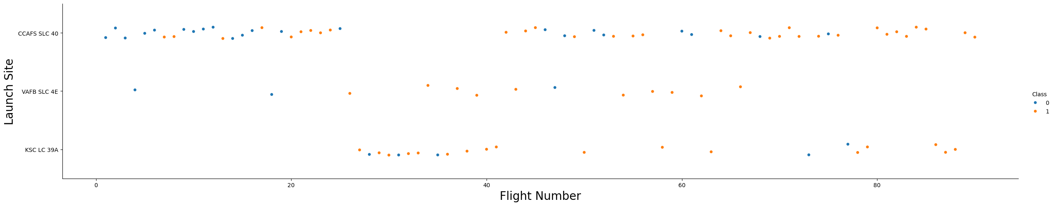
Flight Number vs. Launch Site
CCAFS SLC 40 had more flights than the other launch sites
However, the VAFB SLC 4E had the biggest percentage of successful launches out of all of them, even though it has the lowest number of launches
KSC LC 39A is the second in terms of number of launches. However, the number of failed launches is higher than VAFB SLC 4E , but lower than CCAFS SLC 40

Slide 19
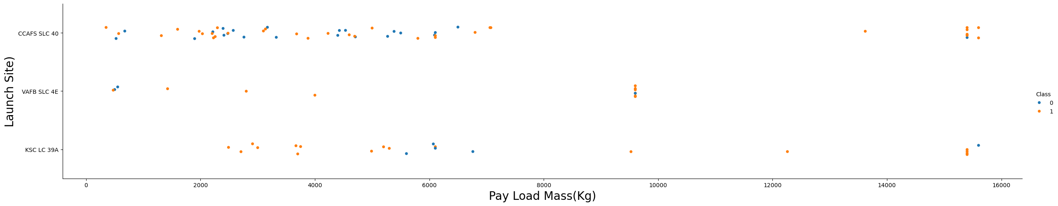
Payload vs. Launch Site
CCAFS SLC 40 was focused more on launches with mostly light payloads, compared to the rest. However, it has the higher number of launches with heavier payloads
A high percentage of failed launches occur with lighter payloads
VAFB SLC 4E had most of its launches with medium sized payloads
KSC LC 39A has its launches with a wide range of payloads
Like CCAFS SLC 40, it had a high percentage of failed launches occuring with lighter payloads

Slide 20
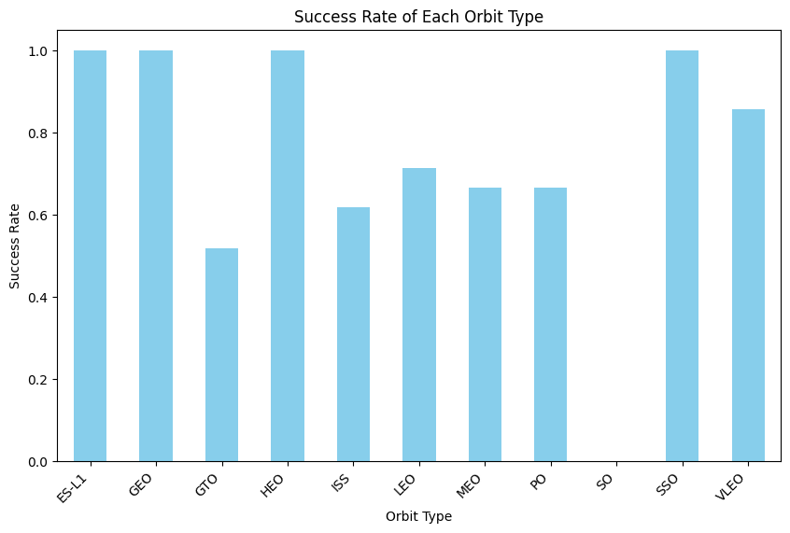
Success Rate vs. Orbit Type
The bar chart shown here represents the success rate for the orbit types
ES-L1, GEO, HEO and SSO are the best orbit type, all of them having 1.0 success rate
VLEO is not far behind in terms of success rate. However, it is a noticeable difference of approximatively 0.2
GTO, ISS, LEO, MEO, PO are similar in terms of success rate, with GTO having the lowest success rate out of the group
SO has the lowest success rate out of all the orbit types in the bar chart

Slide 21
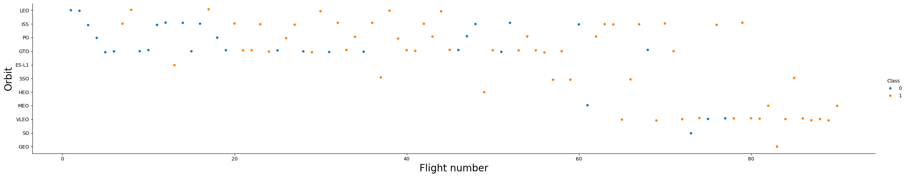
Flight Number vs. Orbit Type
The plot chart shown here represents the flight number for the orbit types
GTO has the largest amount of flights
SO focused more on the later flight
SO only has unsuccessful launches
SSO and GEO only has successful launches. However, they have the lowest amount of launches

Slide 22
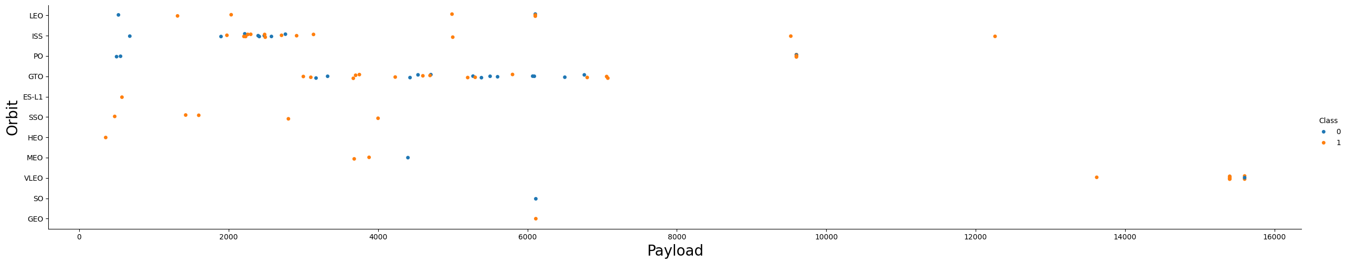
Payload vs. Orbit Type
The plot chart shown here represents the payload range for the orbit types
Most of the orbits focused of the lighter payloads
VLEO had most of the launches with large payload
The launches with large payloads had a higher chance of a successful launch then launches with lighter payloads

Slide 23
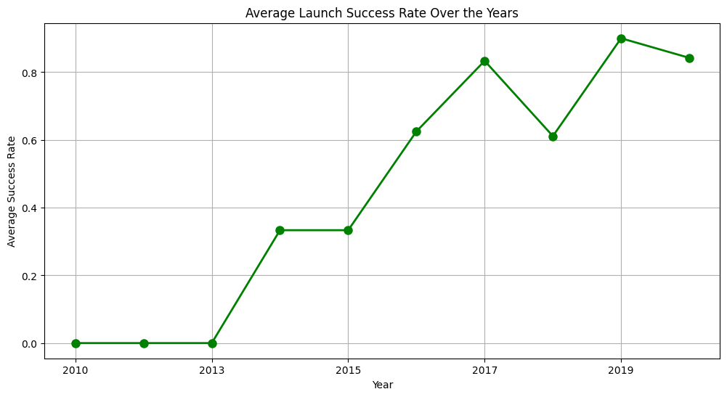
Launch Success Yearly Trend
As observed here, the success rate has increased over the years, starting with the year 2014
In 2018, the success rate has dropped, compared to 2017, to the same rate of the year 2016
The year with the highest success rate was the year 2019

Slide 24
All Launch Site Names
The result displays the names of the unique launch sites where SpaceX missions have been conducted.
Each launch site name is listed on a separate line.
The launch sites mentioned are CCAFS LC-40, VAFB SLC-4E, KSC LC-39A, and CCAFS SLC-40.
This information is useful for understanding the geographical locations from which SpaceX has conducted its missions.
Launch_Site
CCAFS LC-40
VAFB SLC-4E
KSC LC-39A
CCAFS SLC-40

Slide 25
Launch Site Names Begin with 'CCA'
These records display launches from launch site "CCAFS LC-40."
Each row represents a launch event, including details such as the date, time, booster version, payload, payload mass, orbit, customer, mission outcome, and landing outcome.
The results indicate various missions conducted by SpaceX, including spacecraft qualification, demonstration flights, and missions for NASA under programs like COTS (Commercial Orbital Transportation Services) and CRS (Commercial Resupply Services).
Additionally, the landing outcomes are provided, indicating whether the booster attempted a landing and its outcome.
Date | Time (UTC) | Booster_Version | Launch_Site | Payload | PAYLOAD_MASS__KG_ | Orbit | Customer | Mission_Outcome | Landing_Outcome
2010-06-04 | 18:45:00 | F9 v1.0 B0003 | CCAFS LC-40 | Dragon Spacecraft Qualification Unit | 0 | LEO | SpaceX | Success | Failure (parachute)
2010-12-08 | 15:43:00 | F9 v1.0 B0004 | CCAFS LC-40 | Dragon demo flight C1, two CubeSats, barrel of Brouere cheese | 0 | LEO (ISS) | NASA (COTS) NRO | Success | Failure (parachute)
2012-05-22 | 7:44:00 | F9 v1.0 B0005 | CCAFS LC-40 | Dragon demo flight C2 | 525 | LEO (ISS) | NASA (COTS) | Success | No attempt
2012-10-08 | 0:35:00 | F9 v1.0 B0006 | CCAFS LC-40 | SpaceX CRS-1 | 500 | LEO (ISS) | NASA (CRS) | Success | No attempt
2013-03-01 | 15:10:00 | F9 v1.0 B0007 | CCAFS LC-40 | SpaceX CRS-2 | 677 | LEO (ISS) | NASA (CRS) | Success | No attempt

Slide 26
Total Payload Mass
The total payload mass across all records is 45596 kilograms
This represents the combined mass of all payloads launched in the dataset.
total_payload_mass
45596

Slide 27
Average Payload Mass by F9 v1.1
The average payload mass across all records is 2928.4 kilograms.
This value represents the mean mass of payloads launched in the dataset.
average_payload_mass
2928.4

Slide 28
First Successful Ground Landing Date
The date of the first successful landing in the dataset is December 22, 2015
This indicates the first instance where SpaceX successfully landed a booster after a launch mission
first_successful_landing_date
2015-12-22

Slide 29
Successful Drone Ship Landing with Payload between 4000 and 6000
The query result presents four booster versions: F9 FT B1022, F9 FT B1026, F9 FT B1021.2, and F9 FT B1031.2.
These are specific identifiers for Falcon 9 Full Thrust boosters used in SpaceX missions.
Each booster version corresponds to a particular iteration or modification of the Falcon 9 rocket used in different launch missions.
Booster_Version
F9 FT B1022
F9 FT B1026
F9 FT B1021.2
F9 FT B1031.2

Slide 30
Total Number of Successful and Failure Mission Outcomes
The query result shows that there have been 98 missions with a "Success" outcome
This indicates that out of the total count of missions analyzed, 98 of them were completed successfully according to the defined criteria or objectives
Mission_Outcome | total_count
Success | 98

Slide 31
Boosters Carried Maximum Payload
Booster_Version
F9 B5 B1048.4
F9 B5 B1049.4
F9 B5 B1051.3
F9 B5 B1056.4
F9 B5 B1048.5
F9 B5 B1051.4
F9 B5 B1049.5
F9 B5 B1060.2
F9 B5 B1058.3
F9 B5 B1051.6
F9 B5 B1060.3
F9 B5 B1049.7
The query result provides a list of Booster Versions for Falcon 9 rockets.
Each entry corresponds to a specific booster version used in different launches.
The booster versions listed include B1048.4, B1049.4, B1051.3, B1056.4, B1048.5, B1051.4, B1049.5, B1060.2, B1058.3, B1051.6, B1060.3, and B1049.7.
These designations are used to track and identify different iterations or versions of the Falcon 9 rocket boosters used in SpaceX missions

Slide 32
2015 Launch Records
The query result shows two records indicating SpaceX Falcon 9 launches with landing outcomes recorded as "Failure (drone ship)" during different months
The first record occurred in January with Booster Version F9 v1.1 B1012 launched from Cape Canaveral Air Force Station (CCAFS) LC-40
The second record took place in April with Booster Version F9 v1.1 B1015 also launched from CCAFS LC-40
These entries provide information on specific launch dates, landing outcomes, booster versions, and launch sites for Falcon 9 missions where the landing attempt on the drone ship was unsuccessful
month | Landing_Outcome | Booster_Version | Launch_Site
01 | Failure (drone ship) | F9 v1.1 B1012 | CCAFS LC-40
04 | Failure (drone ship) | F9 v1.1 B1015 | CCAFS LC-40

Slide 33
Rank Landing Outcomes Between 2010-06-04 and 2017-03-20
The query result provides a breakdown of landing outcomes for SpaceX missions, along with the corresponding count of occurrences and their respective ranks based on frequency.
Landing_Outcome | outcome_count | outcome_rank
No attempt | 10 | 1
Success (drone ship) | 5 | 2
Failure (drone ship) | 5 | 2
Success (ground pad) | 3 | 4
Controlled (ocean) | 3 | 4
Uncontrolled (ocean) | 2 | 6
Failure (parachute) | 2 | 6
Precluded (drone ship) | 1 | 8

Slide 34

Section 3

Slide 35
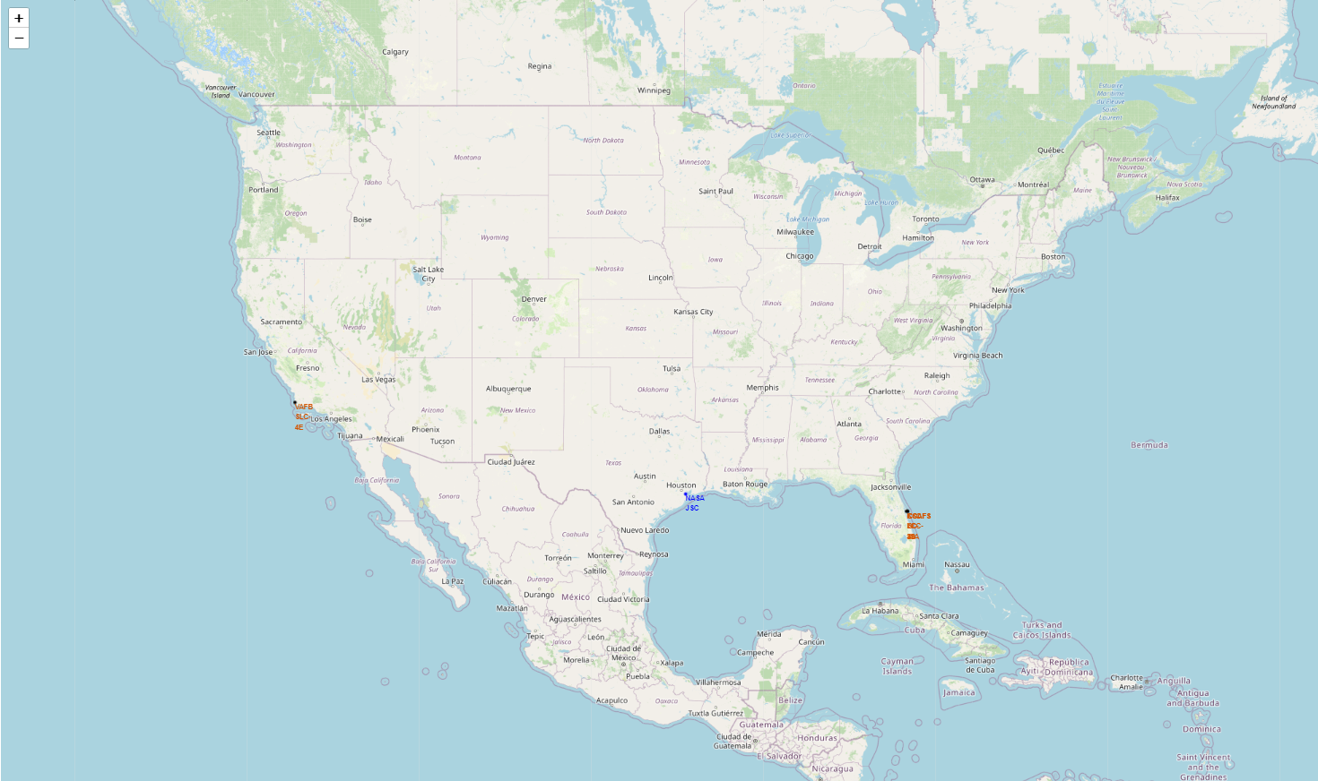
Global Map of SpaceX Launch Sites
The screenshot depicts a global map generated using Folium, showing the locations of SpaceX launch sites marked with distinct markers.
Each launch site is represented by a marker, with labels indicating the site names.
The markers are color-coded based on the success rates of launches from each site, providing insights into the performance of each location.
Key elements include the launch site markers, labeled with site names, and the color-coded markers indicating success rates.
The map allows for easy visualization of the distribution of launch sites across different regions of the world, highlighting strategic locations near coastlines.
Through this visualization, it's evident that SpaceX has strategically positioned its launch sites in various geographic locations to optimize mission success and access to different orbital inclinations.

Slide 36
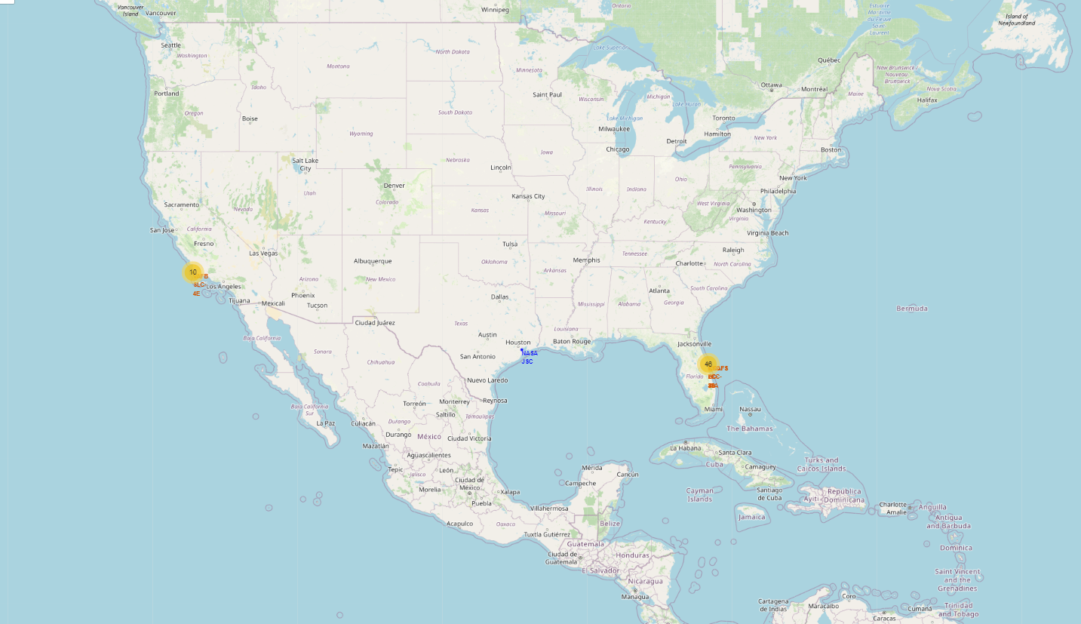
SpaceX Launch Success Rates by Site
The screenshot showcases a Folium map with color-labeled launch outcomes for each SpaceX launch site.
Each marker represents a launch record, color-coded to indicate whether the launch was successful (green) or failed (red).
The markers are clustered to simplify visualization, with each cluster representing multiple launch records at the same coordinates.
By observing the distribution of green (successful) and red (failed) markers across different launch sites, one can identify sites with higher success rates.
The map enables easy identification of launch sites with consistently high success rates, providing insights into the reliability and performance of each site.
This visualization aids in understanding the spatial distribution of launch outcomes and highlights areas where further optimization may be required to improve success rates.

Slide 37
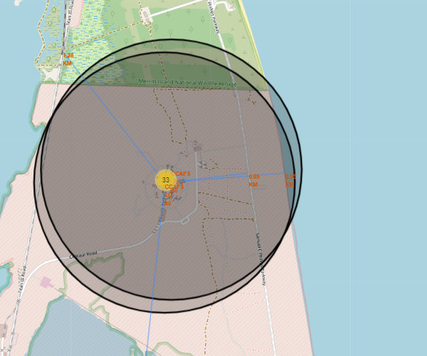
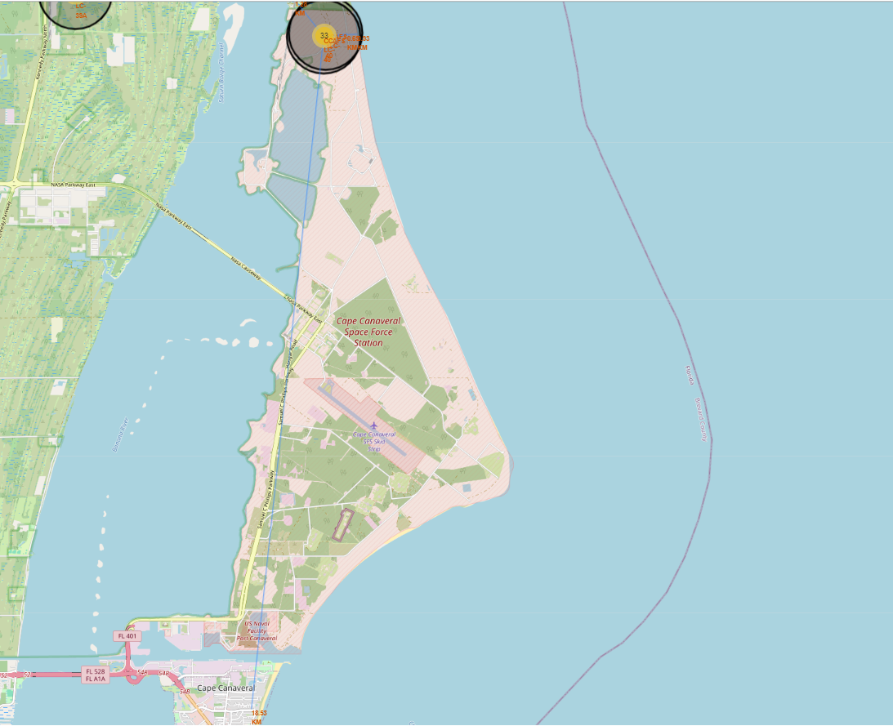
Proximity Analysis of Launch Site: CCAFS LC-40
The screenshots depict a detailed proximity analysis of the launch site CCAFS LC-40 using a Folium map.
Various proximities such as railway, highway, and coastline are marked with distance calculated and displayed.
Each proximity point is marked with a customized icon, making it easy to distinguish between different types of proximities.
Distance lines are drawn from the launch site to each proximity point, providing a visual representation of their spatial relationship.
The distances between the launch site and proximities, including railway, highway, and coastline, are clearly labeled, aiding in understanding their proximity to the launch site.
This analysis helps in assessing the accessibility and environmental factors associated with the launch site, contributing to informed decision-making regarding site selection and infrastructure planning.

Slide 38

Section 4

Slide 39
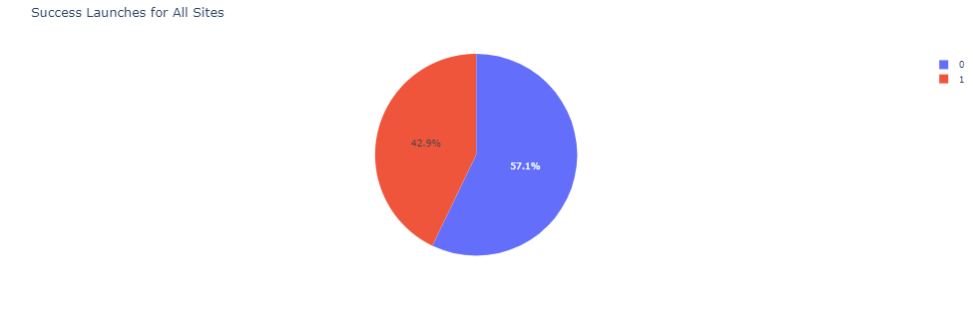
Success Launches for all Sites
The pie chart here represents the success rate for all the launches from all the launch sites
Most of the overall launches were unsuccessful

Slide 40
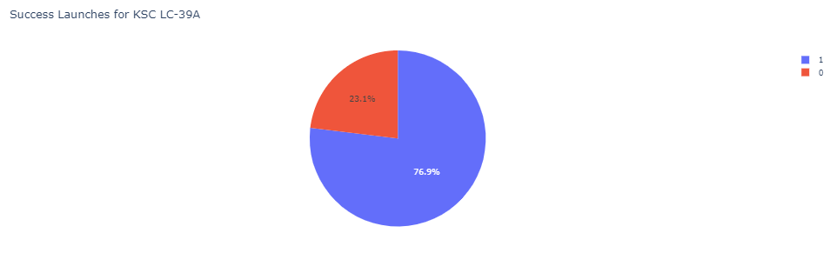
Success Launches for KSC LC-39A
The pie chart shown here represents launch site with highest launch success ratio
More than three quarters of the launches on KSC LC-39A were successful

Slide 41
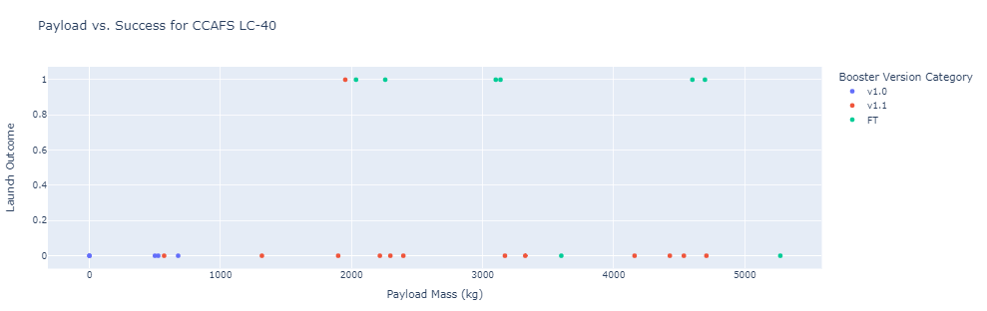
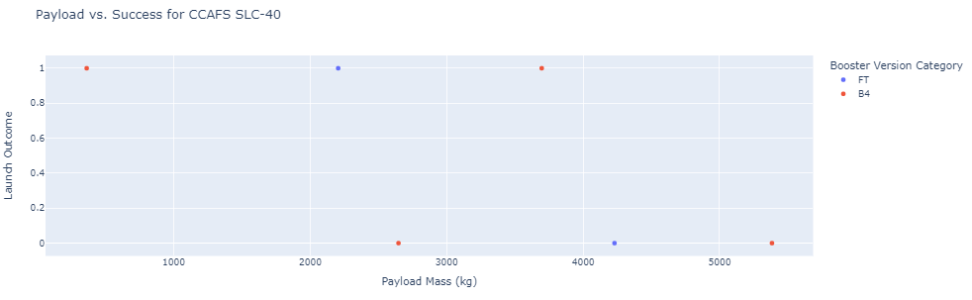


Payload vs. Launch Outcome scatter plot for all sites
Every single launch site , except CCAFS SLC-40, had a better outcome when using the FT Booster Version than the other versions
FT Booster Version worked better on lighter payloads
KSC LC-39A had a better outcome, no matter the payload, compared the other launch sites
V 1.1 Booster Version has the lowest outcome overall on all launch sites

Slide 42

Section 5

Slide 43
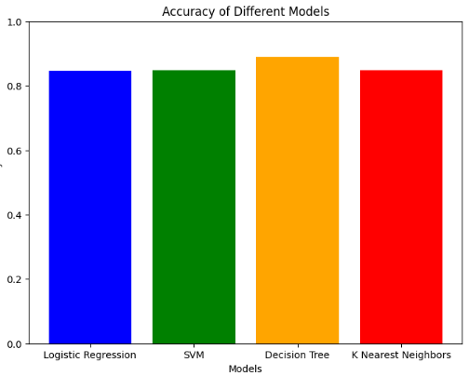
Classification Accuracy
The model with the best accuracy based on the bar chart shown here is the Decision Tree model

Slide 44

Confusion Matrix
The confusion matrix shown here is the confusion matrix for the most accurate model
That model is the Decision tree model

Slide 45
Conclusions
Successful Landings: Most SpaceX missions have resulted in successful landings, either on drone ships or ground pads. This demonstrates the effectiveness of SpaceX's landing technology and capabilities.
Improvements Needed: While successful landings are prevalent, there are still instances of failed or precluded landings. These outcomes highlight areas where further improvements may be necessary to enhance the reliability and success rate of SpaceX missions.
Diverse Landing Scenarios: SpaceX missions encounter a variety of landing scenarios, including controlled and uncontrolled ocean landings, as well as failures attributed to drone ships or parachutes. Understanding these diverse outcomes is crucial for optimizing future mission planning and execution.
Mission Outcome Trends: Analyzing mission outcomes over time can reveal trends in SpaceX's performance and technology advancements. Tracking these trends can inform future decision-making and strategic planning for the company.
Overall, the analysis provides valuable insights into the performance and outcomes of SpaceX missions, guiding ongoing efforts to innovate and improve space exploration technologies.

Slide 46
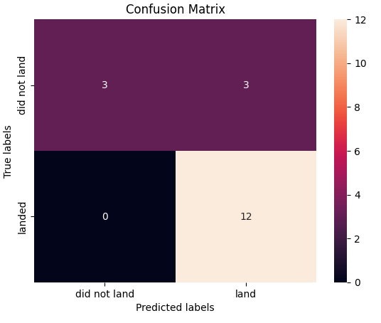
Appendix
Confusion Matrix for KNN
Confusion Matrix for SVM
Confusion Matrix for Logistical Regression

Slide 47


